Slide 1
Christopher Guess
Data Analyst
8/6/2025

Slide 2
About me
I’m a data analyst who loves turning numbers into insights that help solve real world problems, with a long term goal of contributing to the development and responsible use of AI technologies. Through the Google Data Analytics program, I developed skills in SQL, R, and Tableau, which I applied in this Cyclistic case study to craft strategies for converting casual riders to members.
Originally from South Florida and an avid runner, I’m excited to share data driven insights to support Cyclistic’s growth!

Slide 3
Skills & expertise
Spread sheets
SQL
RStudio
Tableau

Slide 4

Design marketing strategies to convert casual riders into annual members by analyzing usage patterns in Cyclistic’s 2024 trip data (~6 Million rides).
Business task
Data source: Motivate International Inc., public license

Slide 5

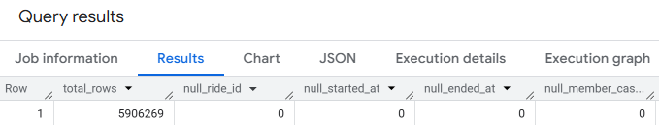
Data Cleaning
Cleaned data in SQL: Removed nulls, calculated ride_length_seconds, derived day_of_week.
In R: Converted dates to POSIXct, set factors for analysis. Visualized in Tableau & Rstudio.

Slide 6
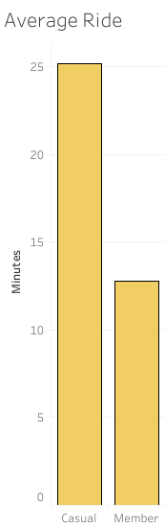
Casual riders average 25.2 minutes per ride vs. 12.8 for members, indicating leisure use.
With this data we can conclude that casual riders ride longer,more than 50% longer, compared to members.

Slide 7
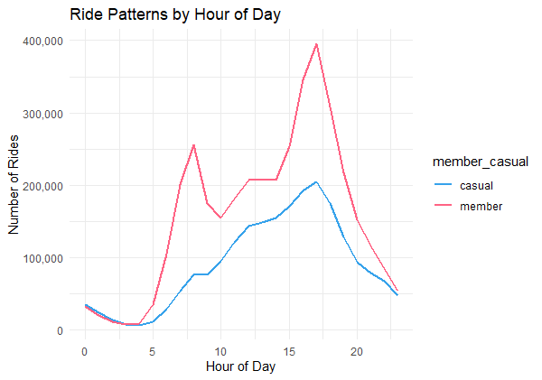
Casual riders peak at 5 PM, members at 8 AM and 5 PM, supporting time specific plans.
Based on the data, both casual riders and members show a peak in usage at 5 PM, suggesting that this time aligns with commuting patterns, particularly the evening work commute.
PM
AM

Slide 8
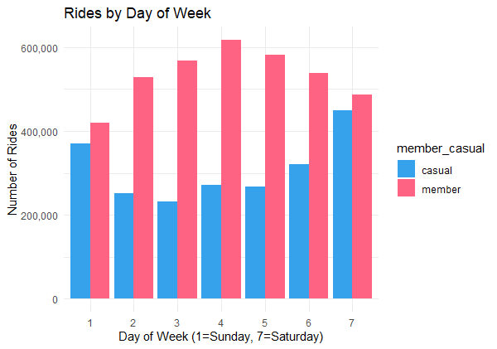
Casual riders peak on Saturday (448,714 rides), members on Wednesday (617,890), ideal for a Weekend Explorer plan.
This bar graph shows that casuals ride more often on the weekend while members ride more on the week day. Also going hand and hand with our previous conclusion, that members more often ride to commute to work.
Sun Mon Tue Wed Thu Fri Sat

Slide 9
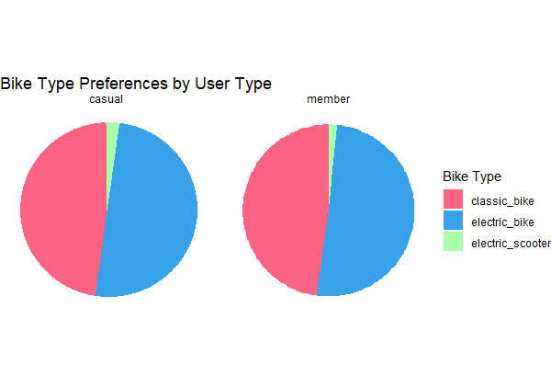
Casual riders use electric bikes for 18.6% of rides vs. 16.6% for classic bikes, suggesting an Electric Membership.
Casual riders favor electric bikes slightly more than classic ones (only 2% more), indicating potential interest in a premium “Electric Membership” tier that emphasizes speed and convenience.
I would call this analysis inconclusive because there isn’t enough data to support the electric membership idea.

Slide 10
Three possible marketing strategies.
Since casuals take 50%+ longer rides than members we could introduce a system where casuals who ride X amount of time get a discount on a membership. Ride more, save more.
Recognizing that casual riders peak ride time is 5PM (commuting from work), we could see if local jobs would help offer an incentive to Cyclistic's membership. Like a go green or get fit type of deal.
Last but not least we could introduce a Weekend Explorer membership tailored to our casual riders who peak on the weekends. This could be a specific membership that works only on the weekends, nudging them to get the full membership if they find themselves needing to use the bikes on the weekday.

Slide 11
Thank you!
Questions, comments?

Slide 12
Email: Chrisguess.t@gmail.com
LinkedIn: Christopher Guess | LinkedIn

